Slide 1
Python Part IV
Modules & Packages
Namespaces & Scopes
Exceptions

Slide 2
Modules
If you exit the interpreter after defining functions and variables, they are lost
Instead, you can save them in a file an run the file’s content as input to the interpreter
This is known as a script
You can also reuse functions across multiple programs
You save the functions definitions in a *.py file
Such file is called a module, and it’s named after the file
You can import the module into other files or into the interpreter

Slide 3

Modules Names
A module’s name can be accessed by a global variable of that module called __name__
Calling __name__ in the interpreter results in:
This is the module the Python interpreter works in
If you create a module called hello.py you can import it and check for it’s name:
Notes:
נשים לב שאלו שני קווים תחתונים מופרדים, ברצף, לפני ואחרי

Slide 4

Using Modules
Importing a module does not enter the function names defined in it directly to the current symbol table
It only enters the module’s name there
Use the module’s name as prefix to call its functions
If you intend to use a function often you can assign it a local name:
mySqrt = math.sqrt
mySqrt(4) 2.0

Slide 5
Modules’ Symbol Table
Each module has its own private symbol table
The author of a module can define and assign values to global variables inside the module
No clash with global variables from other modules
Importing scripts can access modules’ global variables:
module_name.variable_name
Modules can import other modules
The imported modules names are placed in the importing module’s global symbol table
It is customary but not required to place all import statements at the beginning of a module (or script)

Slide 6
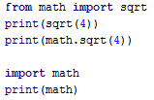
Importing to Local Symbol Table
We can import specific functions to the local symbol table and call them directly
This does not import the module itself and we cannot call module. function()
from math import * is possible but not recommended
it brings an unknown set of names into the interpreter, possibly hiding your own

Slide 7



Executing Modules as Scripts
Let’s define a file called printer.py
If we import the file, myPrint(“hello”) will execute
We can alter the executable code in printer.py to be:
This way, if we import printer.py the code won’t run
OTOH, if we run printer.py itself the code will run
Notes:
OTOH – on the other hand

Slide 8

Standard Modules
Python comes with a library of standard modules
Some modules are built into the interpreter
They provide access to operations that are not part of the core of the language but are nevertheless built-in
for efficiency reasons
To support OS primitives such as system calls
Some are system dependent, e.g. : winreg for windows
The sys module is built-into every Python interpreter
sys.path is a list of search paths for modules
Notes:
Sys.path
נותן את כל ה"מקומות" שבהן מתבצע חיפוש עבור מודלים(או קבצים אחרים אולי) בין אם אלו מודלים מובנים בשפה או מודלים שאנחנו יצרנו.

Slide 9
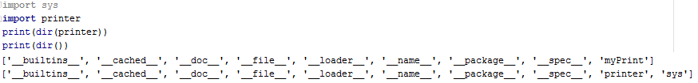

The dir() function
dir(module) returns all the names module defines
It lists all the objects, functions, variables, and modules
dir() lists the names currently defined
dir() does not list built-in functions and variables
they are defined in the standard module builtins
We can also call dir() on any object or class

Slide 10
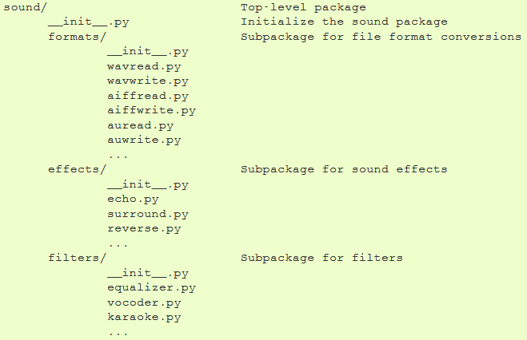
Packages
Packages are a modules hierarchy with “dotted names”
A.B designates a submodule B in a package A
Consider the following structure

Slide 11
Packages (2)
The __init__.py files are required to make Python treat the directories as containing packages
They can be empty, or contain initialization code
Examples for loading modules and functions:
Loading a submodule
Calling its function
Loading the actual submodule
Calling its function
Loading the function itself
Calling the function directly

Slide 12
Packages (3)
from sound.effects import * does not load all the submodules in the package
It only loads the submodules’ names and other names defined in the package and runs the code in __init__.py
If __init__.py includes the following code:
__all__ = ["echo", "surround", "reverse"]
Then the submodules listed on __all__ are also loaded
It is usually best to load the specific modules you need from a package
Notes:
https://docs.python.org/3.5/tutorial/modules.html#packages

Slide 13
Namespaces
A namespace is a mapping from names to objects
Example: x=4. Name: ‘x’, Object: an integer.
Namespaces samples:
The set of built-in names (dir(builtins) lists all of them)
The global names in a module
The local names in a function call
The set of attributes (methods & data) of an object
The important thing to know about namespaces: there is no relation between names in different namespaces
for instance, two different modules may both define a function maximize()
Notes:
כאשר נייבא מודלים שמכילים שמות זהים ולא נקרא להם בעזרת שם המודל. , המפרש יתייחס רק למודול האחרון שיובא !!!
למשל:
ייבאנו שני מודולים, מודל_1 ו- מודל_2 בסדר הזה! אם לשניהם יש פונקציה שקוראים לה למשל foo שמדפיסה את שם המודול/namespace העכשווי וייבאנו אותה גם אז
בקריאה לפוקנציה זו יודפס מודל_2.

Slide 14
Namespaces Lifetime
Namespaces are created at different moments and have different lifetimes
The builtin namespace is created when the interpreter starts-up and is never deleted
The global namespace for a module is created when the module definition is read in and normally never deleted
Statements executed within __main__ have their own global namespace
The local namespace for a function is created when the function is called, and deleted when it returns
recursive invocations each have their own local namespace

Slide 15
Scopes
A scope is a textual region of a Python program where a namespace is directly accessible
At any time during execution, the following scopes’ namespaces are directly accessible (in this order):
L: the innermost scope, contains the local names
E: the scopes of any enclosing functions, which are searched starting with the nearest enclosing scope, contains non-local, but also non-global names
G: the scope containing the current module’s global names
B: the namespace containing built-in names

Slide 16
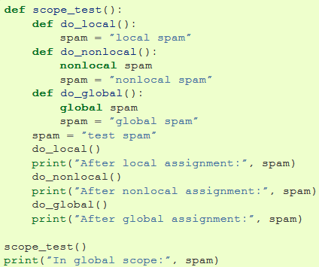

Scopes Detailed Example

Slide 17
Exceptions
Python uses try blocks to enable exception handling
After the try block we can add 1+ except blocks
Each except block can specify the exceptions it handles
except ExeptionType1 :
except (ExeptionType1, ExeptionType2, …) :
except : # excepts all exception types
An optional else block is called when no exception raised
We can use a finally block which executes regardless of whether an exception has occurred
If we use finally, there cannot be any except blocks
Raising exceptions: raise expceptName(“description…”)
Notes:
https://docs.python.org/3/tutorial/errors.html

Slide 18
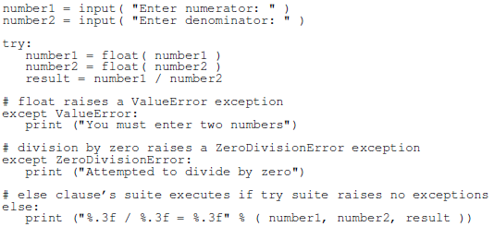
Exceptions Sample

